Slide 1
DATA SCIENCE
10 WEEK PART TIME COURSE
Network Analysis

Slide 2
AGENDA
Network Analysis
Lab
Discussion

Slide 3
WHAT IS NETWORK ANALYSIS?
DATA SCIENCE PART TIME COURSE

Slide 4
WHAT IS A NETWORK?
Many types of real-world problems involve dependencies between observations.
For example:
Town planners are looking at vehicular flows through a city
Sociologist want to understand how people influence others that they know (if at all)
Biologists want to know how proteins regulate the actions of other proteins
Credit card fraud: vendors and card users are nodes in the network, purchases are edges
Social media networks want to identify groups of close friends

Slide 5
WHAT IS A NETWORK?
Problems involving dependencies can often be modelled as graphs, and scientists have developed methods for answering these questions called network analysis.

Slide 6
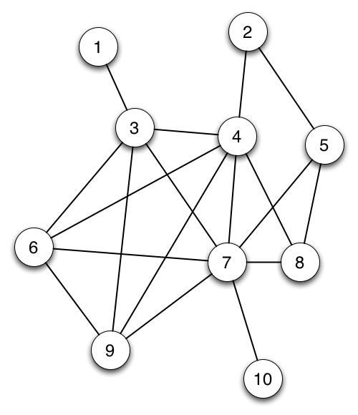
WHAT IS A GRAPH?
A graph consists of a nodes (or vertices) and are connected by edges.
For example the nodes may represent people and the edges are there if a friendship exists.
(DiGraphs have arrows, MultiGraphs have parallel lines between nodes)

Slide 7
WHAT IS A GRAPH?
Nodes = 10
Edges = 18
print networkx.degree(Graph,5)
3

Slide 8
WHAT TO LOOK FOR IN NETWORK ANALYSIS?

Slide 9
IS IT NEARLY A LATTICE?
A lattice has every possible edge
Maximum possible density
Density – connectedness of the graph: ratio of edges to total possible number of edges

Slide 10
networkx
import networkx
Graph = networkx.Graph()
Graph.add_node(’Kirk’)
Graph.add_node(’Spock’)
Graph.add_edge(’Kirk’, ’Spock’)
print networkx.density(Graph)
Graph.add_node(’Janeway’)
print networkx.density(Graph)

Slide 11
Are there any islands?
print list(networkx.connected_components(Trek))
[set(['Kirk', 'Spock']), set(['Janeway'])]
Almost all network analysis assumes full connectivity, which might mean creating a subgraph to analyse:
networkx.subgraph(Trek, ['Kirk', 'Spock'])

Slide 12
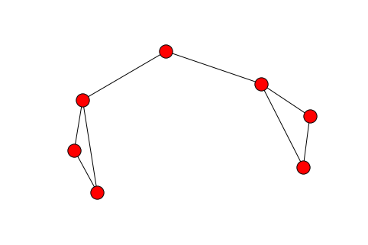
Average clustering coefficient
If three nodes are connected by at least two edges, what is the probability that they are connected by three?
This graph has a clustering coefficient of 0.6666666…
networkx.average_clustering(graph)

Slide 13
Average shortest path
Calculate the shortest path between each pair of nodes, divide by the number of pairs. (Computationally expensive)
nx.average_shortest_path_length(graph)

Slide 14
Characterising Networks
 |  | Clustering Coefficient
 |  | Small | Large
Average Shortest Path | Small (around Log(N)) | Random graph | Small world
 | Large | Chain | Unusual

Slide 15
Small world networks
Have hubs (high degree nodes), and many low-degree nodes
More robust against failure of an individual node?
Examples:
Website navigation menus
Power grids
Telephone call graphs
Social networks
Six degrees of separation (among living people)
There is an effect joining clusters which is not just spatial or temporal proximity

Slide 16
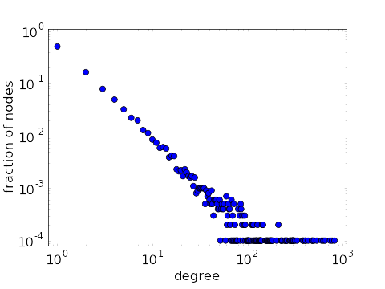
Ultra small worlds are called “Scale Free”
The distribution of the “degree” of a node follows a power law
E.g. double the number of connections = half as many nodes have that number
Do a log-log plot and see if it looks straight

Slide 17
WHAT ARE THE METRICS OF A GRAPH?
How do we know who the key actors (nodes) are in our network ?
We need to calculate some measures of importance (or centrality).
What are some of the ways you might measure an individual’s centrality (there are multiple measures).

Slide 19
WHAT ARE THE METRICS OF A GRAPH?
Degree Centrality - number of edges a node has
Closeness Centrality - the reciprocal of the sum of the shortest path distances from one node to all n-1 other nodes. Since the sum of distances depends on the number of nodes in the graph, closeness is normalized by the sum of minimum possible distances n-1. Higher values of closeness indicate higher centrality
Betweenness Centrality - the sum of the fraction of all-pairs shortest paths that pass through the node v
Eigenvector centrality - computes the centrality for a node based on the centrality of its neighbours
Page Rank - count the number and quality of links to a page to determine a rough estimate of how important the website is. The underlying assumption is that more important websites are likely to receive more links from other websites

Slide 20
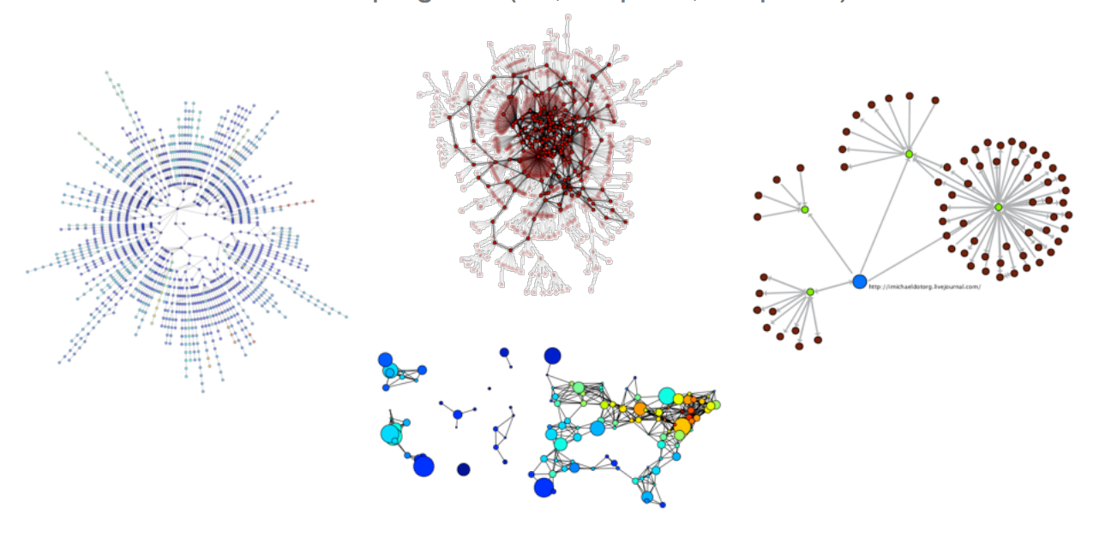
HOW DO WE VISUALISE A GRAPH?

Slide 21
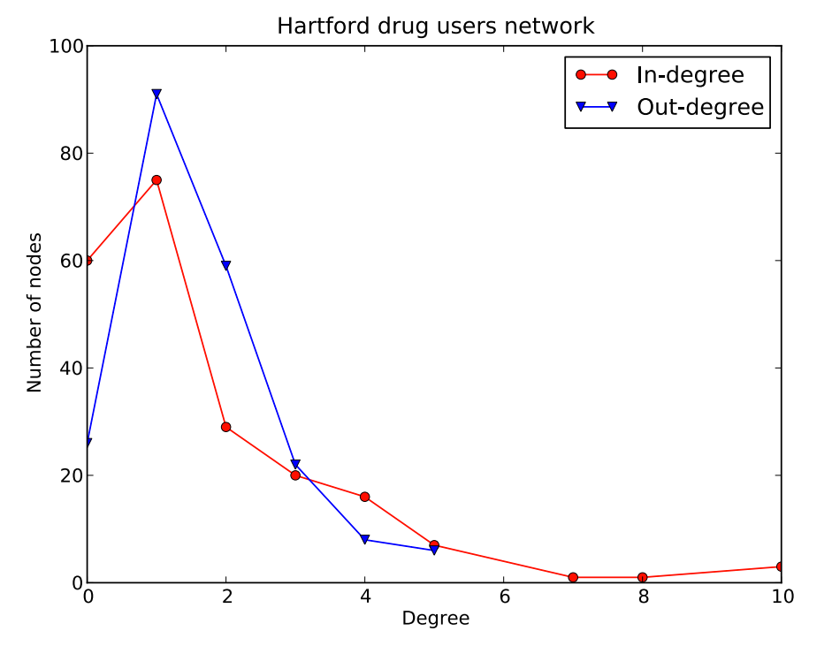
HOW DO WE VISUALISE A GRAPH?

Slide 22
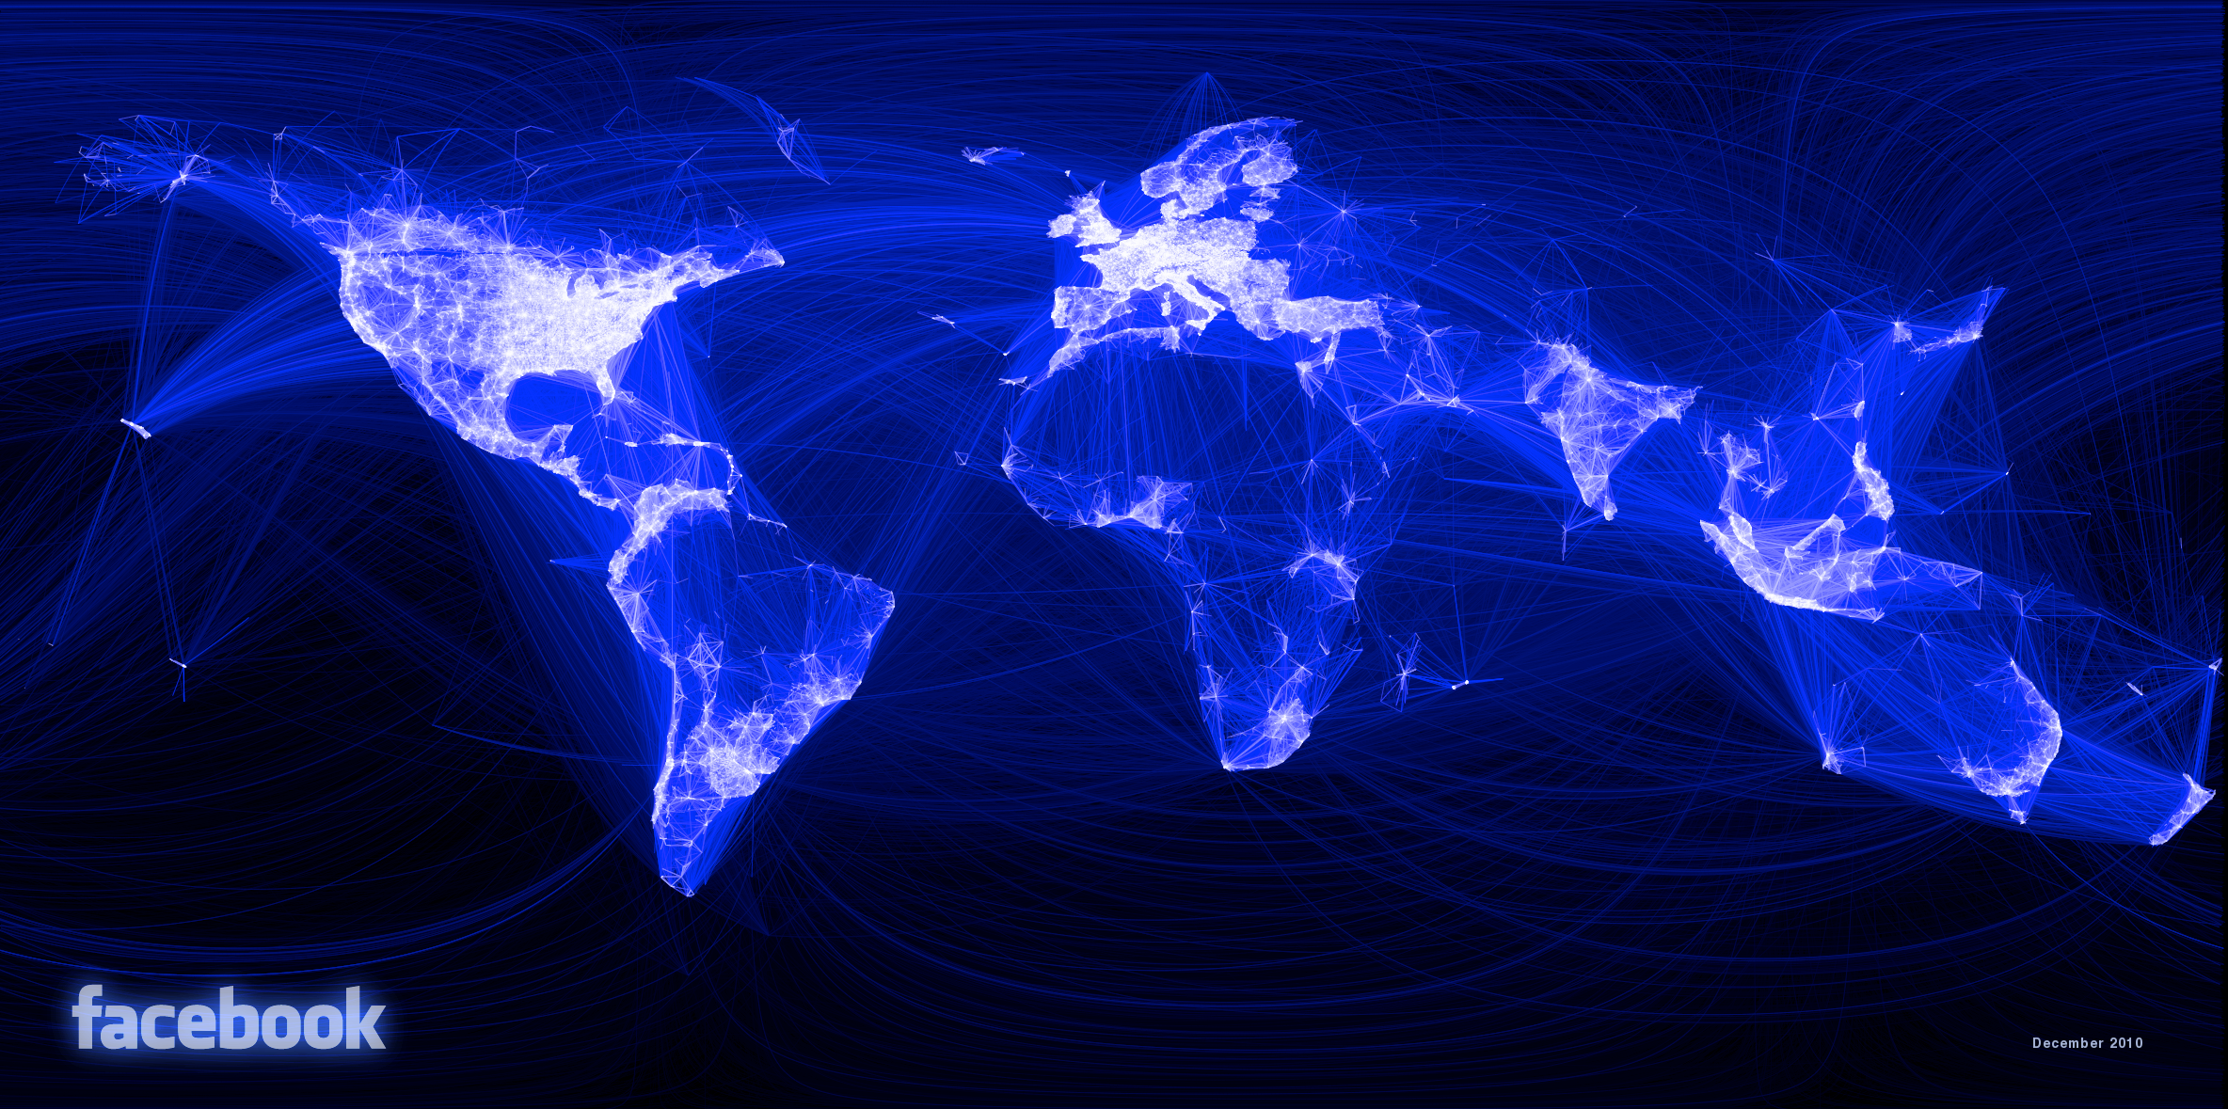
HOW DO WE VISUALISE A GRAPH?

Slide 23
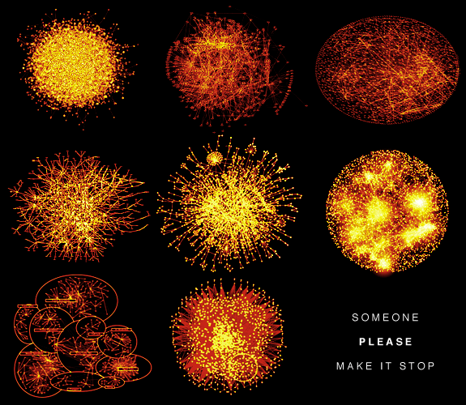
HOW DO WE VISUALISE A GRAPH?

Slide 24
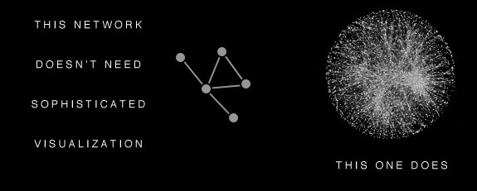
HOW DO WE VISUALISE A GRAPH?

Slide 25
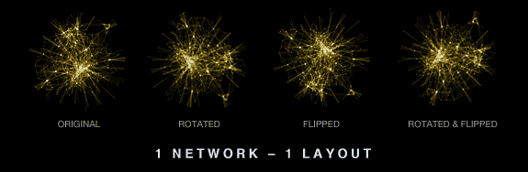
HOW DO WE VISUALISE A GRAPH?

Slide 26
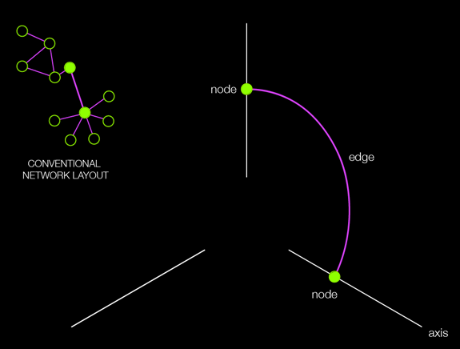
HOW DO WE VISUALISE A GRAPH?

Slide 27
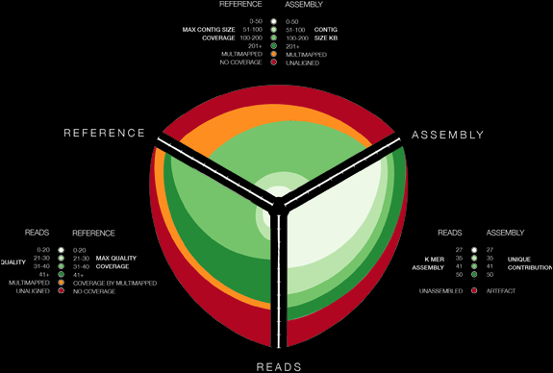
HOW DO WE VISUALISE A GRAPH?

Slide 28
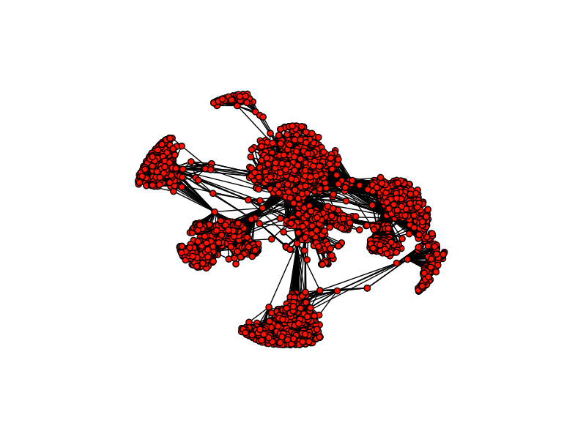
HOW CAN WE FIND COMMUNITIES?

Slide 29
HOW CAN WE FIND COMMUNITIES?
We all know on our Facebook page we have friends we made at different places and stages in our lives. We might have some work friends, school friends, some friends we made travelling, etc…
How might we find good groupings of communities?

Slide 30
HOW CAN WE FIND COMMUNITIES?
The criteria for finding good communities is similar to that for finding good clusters.
We want to maximize intra-community edges while minimizing inter-community edges.
Formally, the algorithm tries to maximize the modularity of network, or the fraction of edges that fall within the community minus the expected fraction of edges if the edges were distributed by random. Good communities should have a high number of intra-community edges, so by maximizing the modularity, we detect dense communities that have a high fraction of intra-community edges.

Slide 31
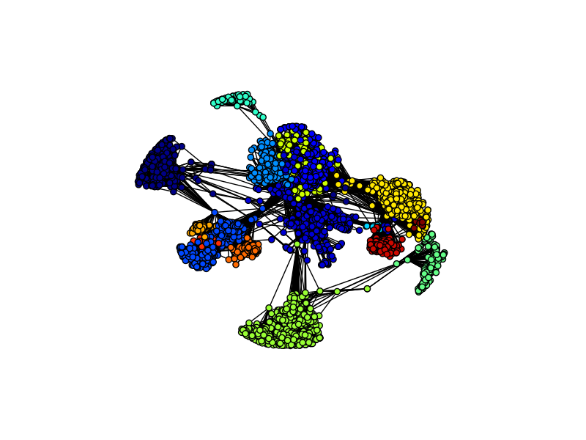
HOW CAN WE FIND COMMUNITIES?

Slide 32
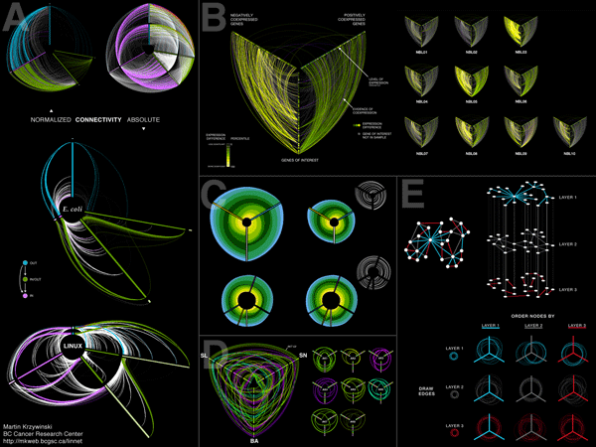
LAB
DATA SCIENCE PART TIME COURSE

